Slide 1
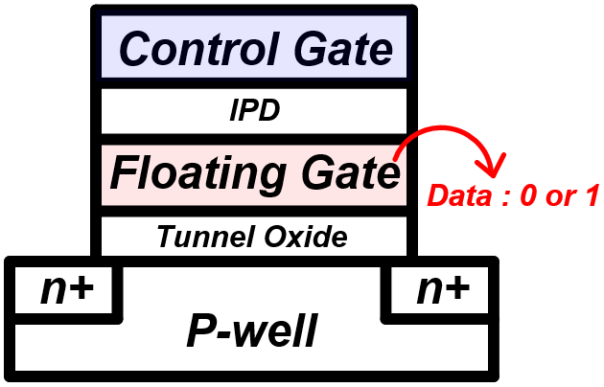
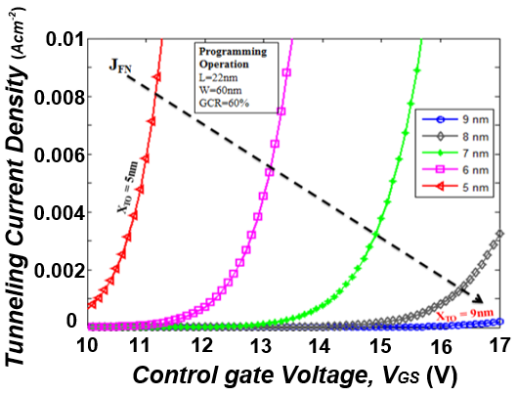
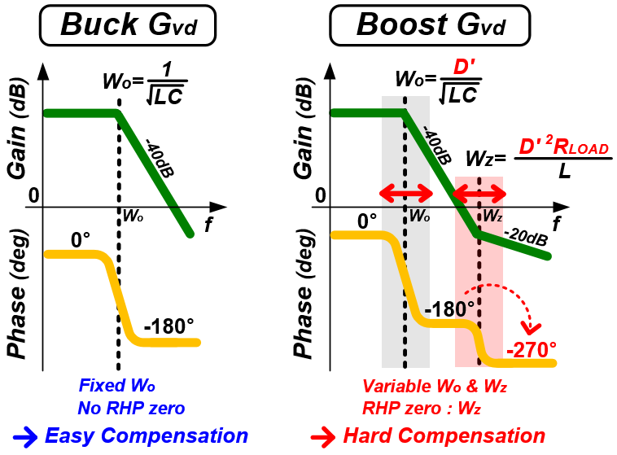
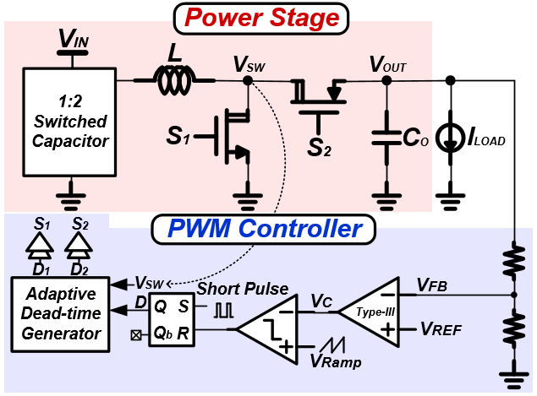
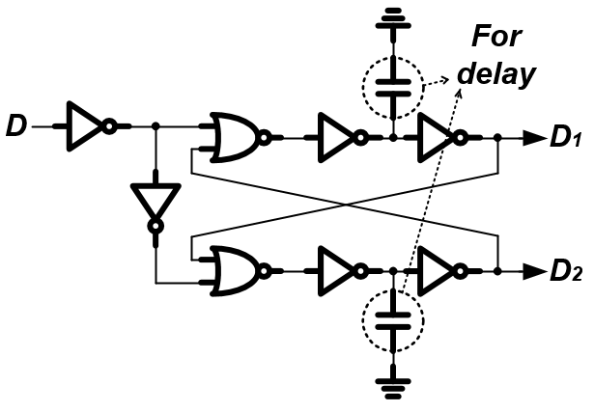
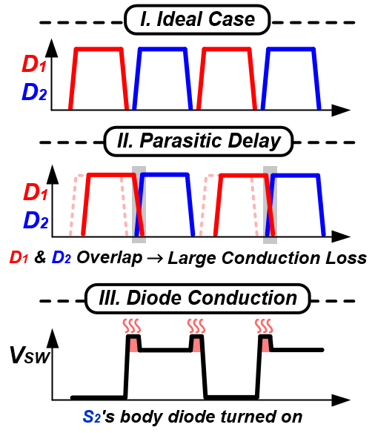
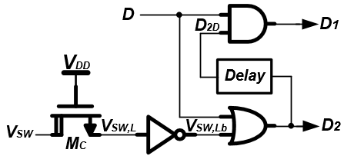
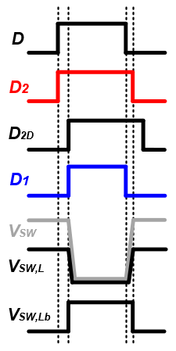
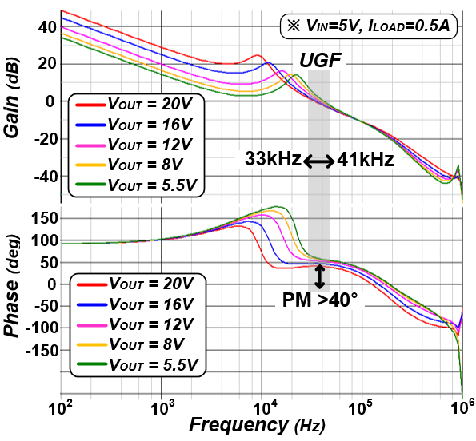
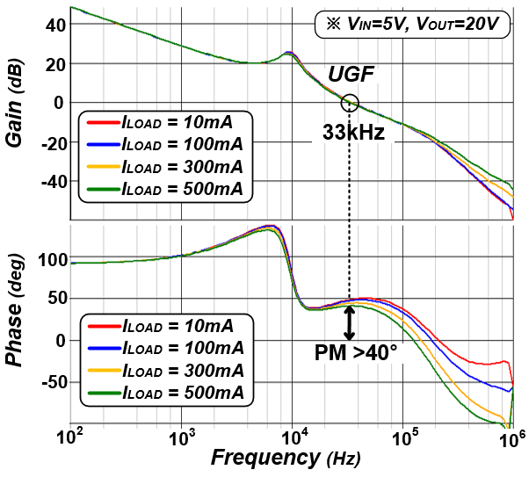
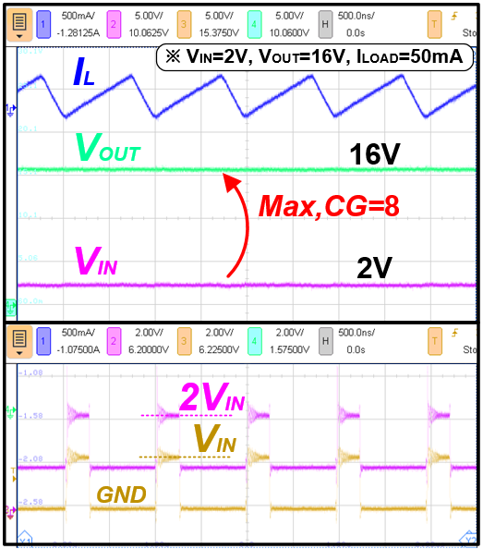
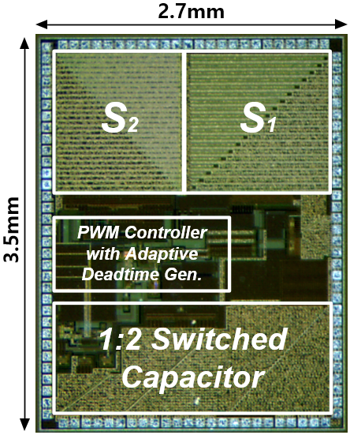
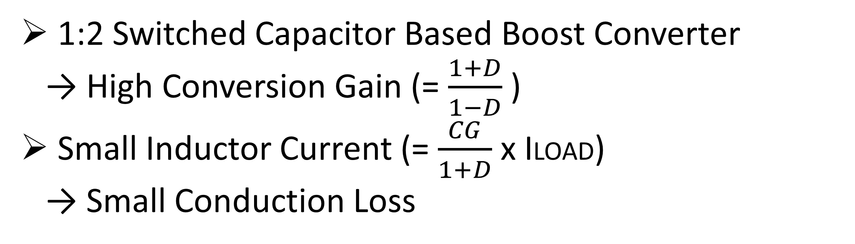
A Switched Capacitor Based DC-DC Boost Converter with Adaptive Dead-time Generator for Solid-State Drives
Seung-Ju Lee, Se-Un Shin
Department of Electrical Engineering,
Ulsan National Institute of Science and Technology (UNIST)
1. Introduction : Boost Converter for Solid-State Drives
<NAND Flash Memory Cell>
▣ Design Goals
High Efficiency
High Conversion Gain
Stability for Wide Output Range (VOUT=5.5~20V)
2. Proposed Structure
3. Proposed Dead-Time Generator
<Conv. Dead-Time Gen>
1:2 Switched Capacitor Based Boost Converter
→ High Conversion Gain (= $\frac{1+D}{1−D}$ )
Small Inductor Current (= $\frac{CG}{1+D}$ x ILOAD)
→ Small Conduction Loss
<Adaptive Dead-Time Gen>
4. Measurement Results
Bode plot of the loop under different output/load conditions
Waveforms of
proposed structure
Chip micrograph
40 degrees or higher phase margin under whole conditions

